Slide 1
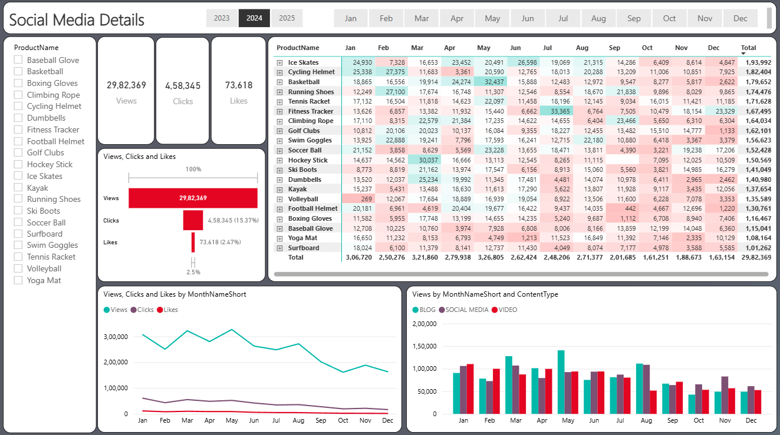
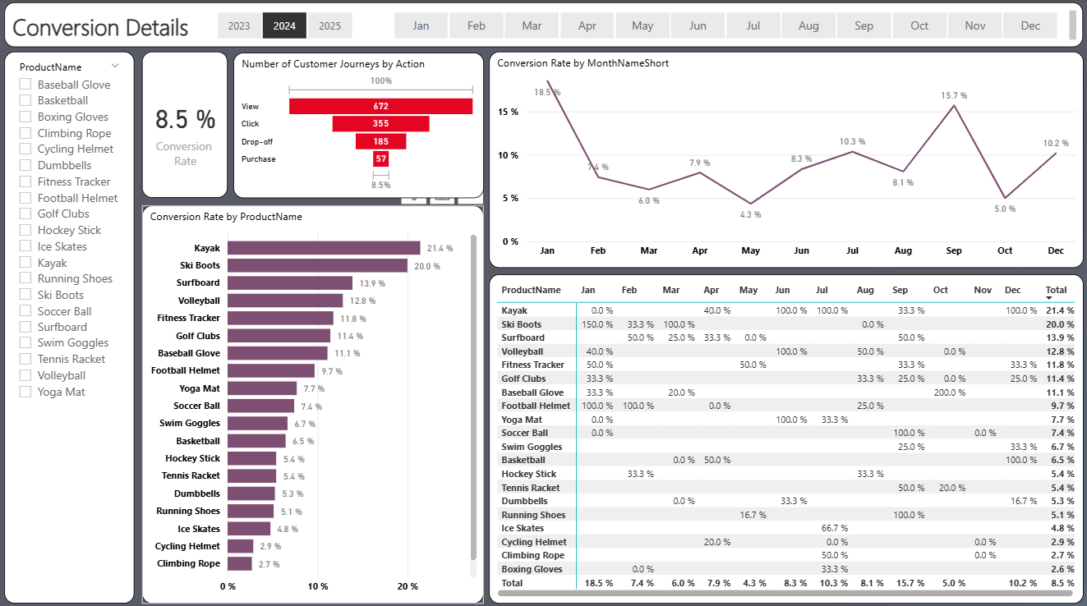
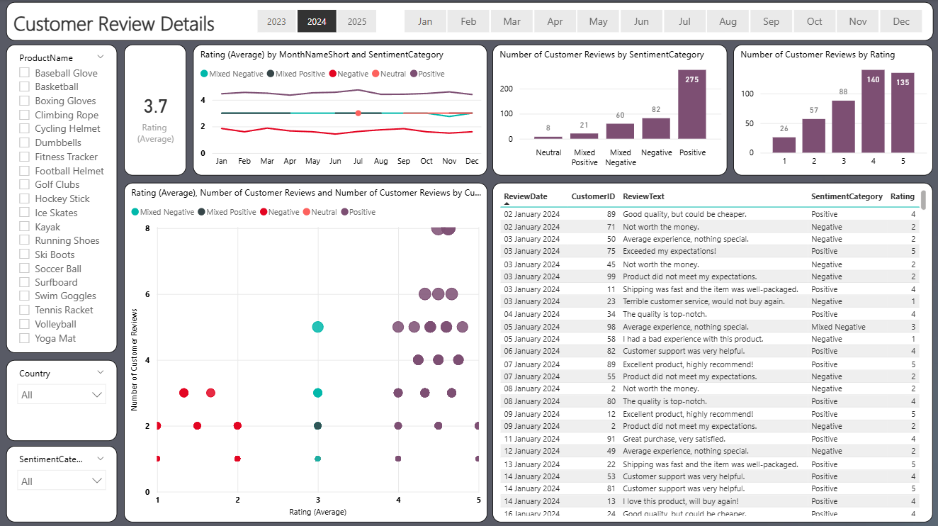
Marketing Analysis of Sports Equipment
Marketing analysis of sports equipment with emphasis on conversions, customer engagement, and reviews. The project framework includes data preparation, visualization, and development of an interactive Power BI dashboard to evaluate product performance, derive insights, and support strategic marketing decisions.
Presented by: Soumyaditya Saha
Email: soumyaditya_2312res654@iitp.ac.in
Tool Used: Power BI, SQL, Python
Date: 02/08/2025

Slide 2
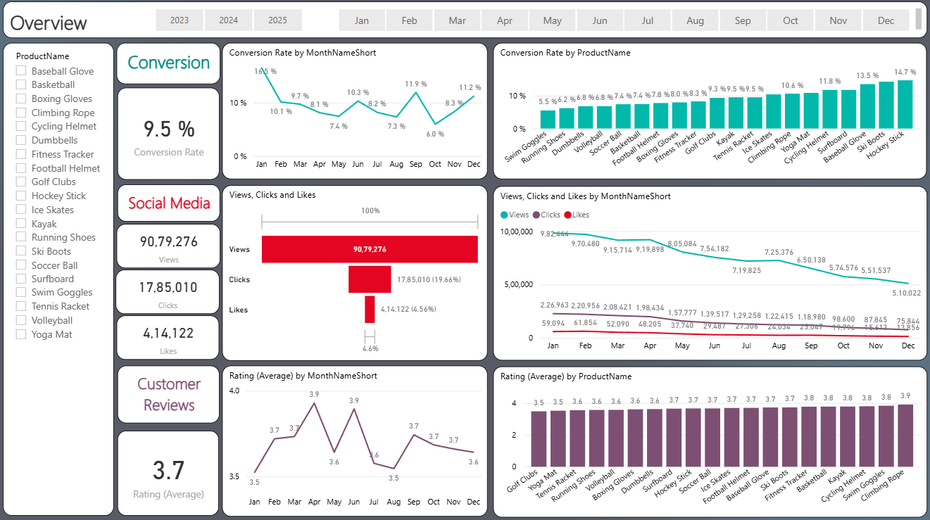

Slide 3

Navigating the Digital Marketplace
In today's highly competitive e-commerce landscape, standing out requires more than just great products. It demands strategic, data-driven decision-making to understand and engage customers effectively.
This analysis focuses on three critical components: product conversion funnels, social media effectiveness, and customer review sentiment.
Our ultimate goal is to deliver actionable insights that optimize product performance and enhance marketing strategies for sustained growth.

Slide 4
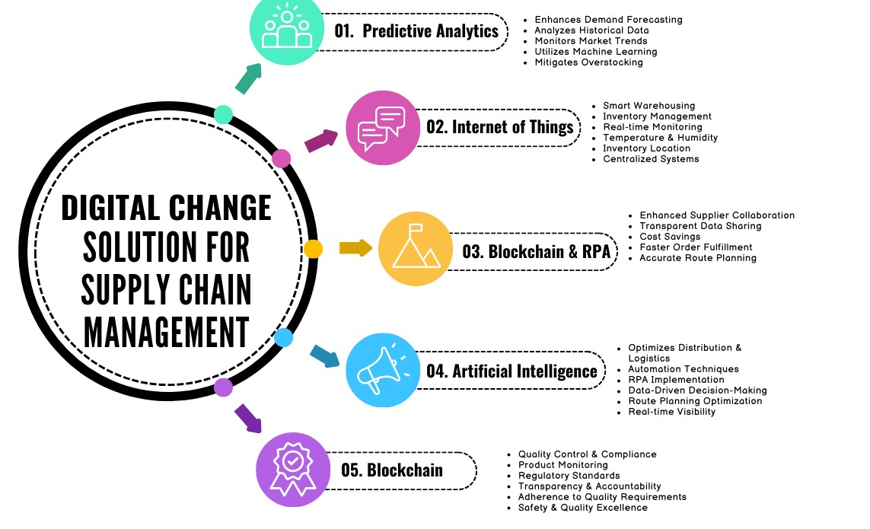
Problem to Potential: Defining Our Path
The Challenge
Businesses often struggle with fragmented insights into how social media engagement, customer sentiment, and complex conversion journeys truly influence product performance. This lack of clarity hinders optimization efforts.
Key Objectives
Analyze product conversions across crucial stages (views, clicks, purchases) to identify bottlenecks.
Evaluate social media effectiveness in driving engagement and traffic.
Identify nuanced customer sentiment from reviews to uncover pain points and delights.
Provide targeted, actionable business recommendations for sustainable growth and improved customer experience.

Slide 5
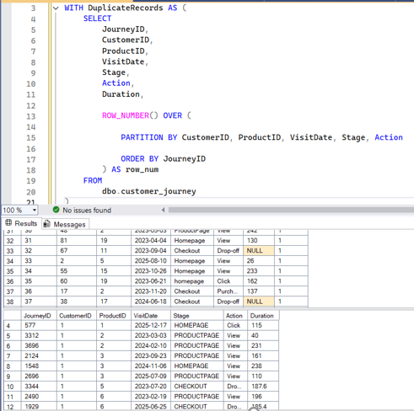
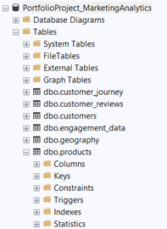
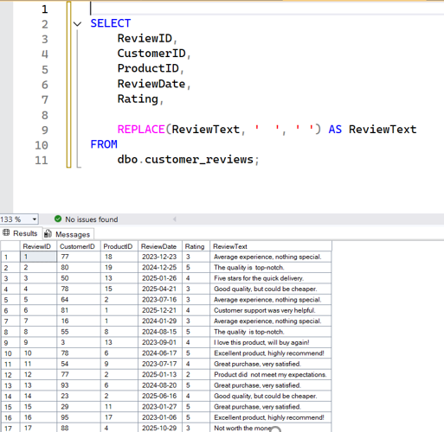
Our Data Foundation
Our analysis is built upon a robust, simulated e-commerce dataset designed to mirror real-world scenarios, ensuring relevant and applicable insights for strategic decision-making.
Primary Database
Key Tables Utilized
PortfolioProject_MarketingAnalytics hosted on SQL Server, serving as the central repository for all e-commerce data.
• customer_journey: Comprehensive visit and action tracking data.
• engagement_data: Social media performance metrics and user interactions.
• customer_reviews: Unstructured customer feedback and ratings.
• products: Detailed product specifications and classifications.
Time Frame
Data spanning from 2023 to 2025, allowing for robust trend analysis, seasonal pattern identification, and future forecasting.

Slide 6
Refining the Raw: Data Cleaning & Preparation
Transforming raw, disparate data into a pristine, actionable dataset is crucial for accurate and reliable analysis. We followed a rigorous, multi-step process:
Duplicate Removal
Standardization
Meticulously identified and eliminated redundant records using SQL’s ROW_NUMBER(), ensuring the uniqueness and integrity of our dataset.
Applied uniformity to product names and critical customer journey stage labels (e.g., Homepage, Checkout, Drop-off) for consistent and clear reporting.
Date Normalization
Sentiment Analysis
Converted raw date fields into easily digestible monthly and quarterly formats, facilitating efficient time-series trend identification and aggregation.
Utilized Natural Language Processing (NLP) to classify customer reviews into Positive, Neutral, Negative, and Mixed sentiments, providing quantifiable customer insights.
Outcome: A clean, structured, and reliable dataset, perfectly primed for sophisticated Power BI dashboard creation and insightful analytics.

Slide 7
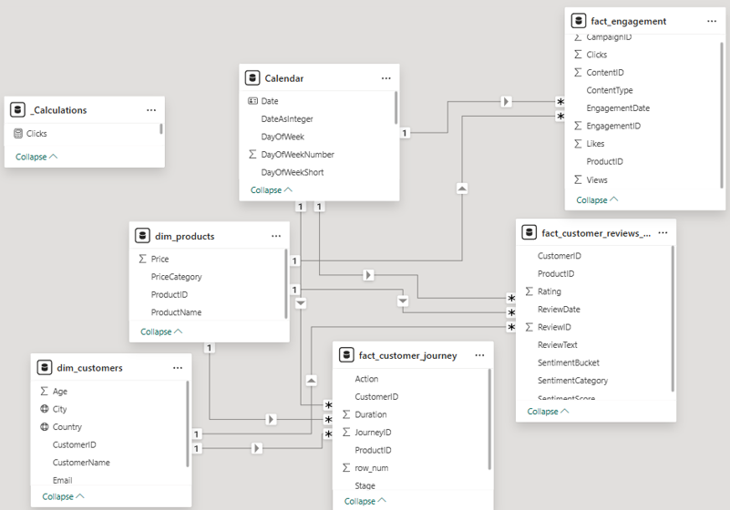
Building the Analytical Backbone: Data Model & Relationships
A well-structured data model is the bedrock of insightful analytics, ensuring seamless data flow and accurate reporting. We established clear, logical relationships between our core entities:
Customers
Who are they?
Products
What do they buy?
Engagement
How do they interact?
Reviews
What do they think?
These relationships, meticulously forged within Power BI, seamlessly link social media interactions, comprehensive customer journey data, and nuanced review sentiments, enabling holistic analysis.
Justification: Our strategic choice of a star schema design
significantly simplifies complex reporting, enhances query
performance, and makes the model highly scalable for future
data integrations and expansions.

Slide 8
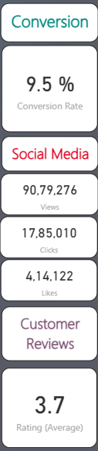
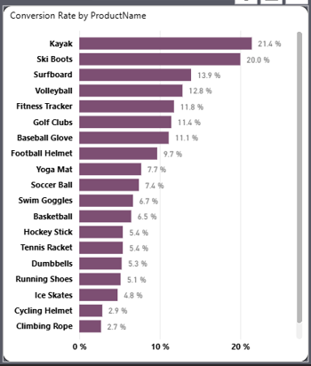
Uncovering Trends: Data Exploration & Summarization
Key Descriptive Statistics
9.5%
Product Performance Insights
Avg. Conversion Rate (Overall)
90M+
High Conversion Champions
Social Media Reach (Total Views)
Kayak and Ski Boots demonstrated
Exceptional conversion rates, proving
their strong market appeal and effective
journey optimization.
3.7/5
Avg. Customer Rating (Across Products)
Low Conversion Opportunities
Overall Trends
Climbing Rope and Cycling Helmet showed notably lower conversion rates, signaling critical areas for focused marketing
interventions and product page optimization.
Our analysis revealed clear seasonal spikes, with Q3–Q4 consistently outperforming other quarters. This indicates prime selling periods and opportunities for targeted campaigns.

Slide 9

Dashboard Overview: The Big Picture
Our comprehensive dashboard provides a holistic view of overall e-commerce performance, integrating key metrics for quick assessment and high-level
strategic decision-making.
Key Insight:
There's a significant alignment between conversion rates and seasonal engagement, highlighting the critical importance of launching and amplifying
campaigns during periods of high user activity.

Slide 10
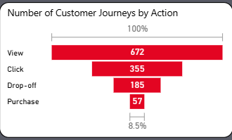
Deep Dive: Conversion Funnel Analysis
Understanding the customer journey is paramount to optimizing conversions. Our detailed funnel analysis dissects performance from initial interest to final purchase, pinpointing drop-off points:
Views
Initial product page visits and impressions.
Clicks
Engaging with product details or adding to cart.
Purchases
Successful conversions and completed transactions.
Drop-offs
Crucial points where customers abandon the journey.
Specifically, Kayak (21.4%) and Ski Boots (20%) lead in conversion rates, with significant monthly peaks observed in January and September.
Actionable Recommendation: Focus intensified marketing budget and resources on high-converting products like Kayak and Ski Boots, strategically aligning campaigns
with their proven peak months (January & September) to maximize ROI and sales volume.

Slide 11
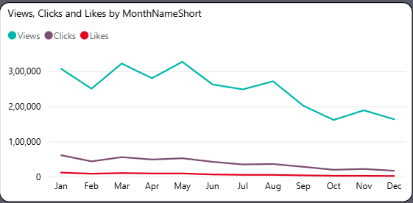
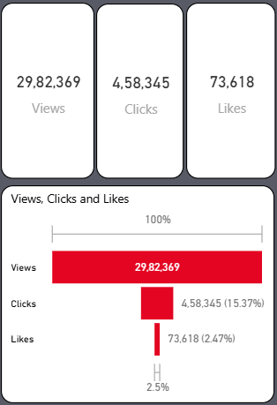

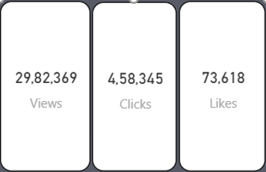
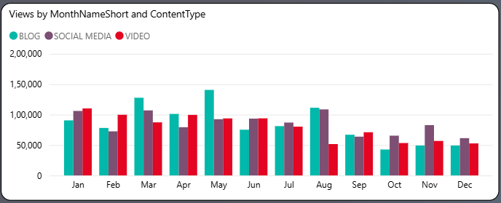
Driving Engagement: Social Media Performance
Social media is a powerful catalyst for engagement and conversion. Our detailed dashboard reveals nuanced insights into its effectiveness across products and content types:
Analyzing the performance of various content types is key to optimizing social media strategy:
Product-level engagement: Identifying which specific products resonate most strongly on social channels, driving attention and interest.
Videos
Monthly activity heatmap: Revealing periods of heightened social media buzz, notably around Ice Skates and Cycling Helmet.
Consistently outperform blogs in driving conversions and overall engagement metrics, indicating high audience preference.
Views vs. Clicks vs. Likes trends: Dissecting the full engagement lifecycle to understand audience interaction patterns.
Blogs
Effective for awareness and providing in-depth information, but show less direct conversion impact compared to videos.
Social Posts
Ideal for quick updates, community interaction, and driving traffic to specific product pages
or promotions.
Key Insight:
Invest heavily in video content production and promotion for maximum social media conversion impact and sustained audience growth, leveraging its superior engagement capabilities.

Slide 12
Unpacking Customer Review Insights
Sentiment Breakdown
Ratings Distribution
While positive sentiment dominates our customer reviews, approximately 30% of feedback falls into negative or mixed categories, indicating areas for focused improvement.
The average product rating stands at 3.7 stars, with a significant number of products clustered in the 3-4 star range. This suggests general satisfaction but also room for distinction.
Correlation Insight
Analysis reveals a clear correlation: products with lower star ratings frequently exhibit clusters of negative sentiment in their reviews, highlighting specific pain points.
"Exceeded my expectations!" vs. "Not worth the money." - These direct customer voices drive our product enhancement priorities.

Slide 13
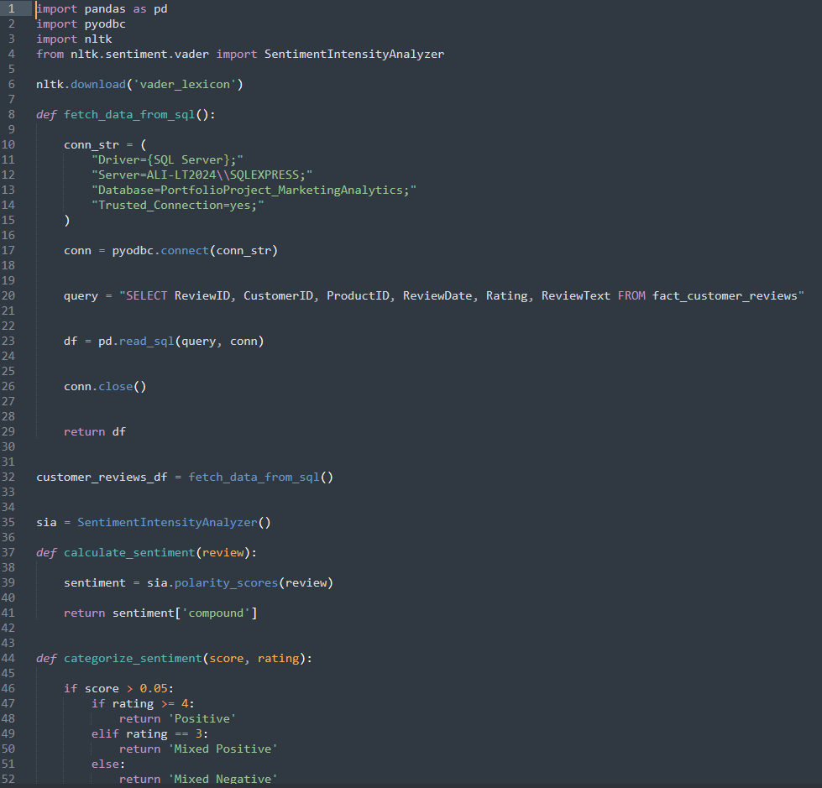
Data Engineering: The Foundation of Insights
Our robust analytics are built upon meticulous data engineering. This involves preparing and refining raw data to ensure accuracy and relevance for
comprehensive analysis.
SQL Query Example: Duplicate Removal
Key Backend Processes
Data Cleaning
Implementing techniques like `ROW_NUMBER()` in SQL for efficient duplicate removal, ensuring data integrity.
Data Preparation
Filtering and structuring diverse journey data specifically for consumption by Power BI dashboards.
Complex Joins
Executing intricate joins across product inventories, customer reviews, and engagement data for a holistic view.
This demonstrates the technical rigor applied to ensure clean, actionable data.

Slide 14
Strategic Insights & Interpretation
Translating data into actionable strategies is crucial. Here are key insights derived from our analysis, guiding future business decisions.
Conversion Efficiency
Social Media Impact
Customer Sentiment Nuances
Outdoor and adventure products, such as Kayaks and Ski Boots, consistently outperform general fitness gear in conversion rates.
While our social media campaigns achieve high reach, the like-to-view ratio stands at a low ~4.5%, indicating potential content quality gaps.
Overall sentiment is positive, but a significant segment of our customer base is price-sensitive. Negative reviews often highlight a mismatch between cost and perceived quality.
Strategic Actions Driven by Data
Targeted Ad Boost
Product Quality Review
Video Content Enhancement
Increase advertising spend on high-performing outdoor/adventure products to capitalize on proven success.
Prioritize enhancing product quality for items receiving consistent low ratings and negative feedback.
Revamp social media video strategy to improve engagement and like-to-view ratios.

Slide 15




Actionable Business Recommendations
Based on our comprehensive analysis, we propose the following strategic recommendations to optimize operations and enhance customer satisfaction.
Marketing
Product Development
Implement seasonal targeting campaigns, focusing on peak periods such as January-February and September for optimal impact.
Systematically address negative reviews through targeted product quality improvements, enhancing overall customer experience.
Customer Engagement
Future Enhancements
Develop personalized campaigns for customers who frequently purchase specific items, fostering loyalty and repeat business.
Integrate predictive modeling capabilities for enhanced demand forecasting, ensuring inventory optimization and reduced waste.

Slide 16
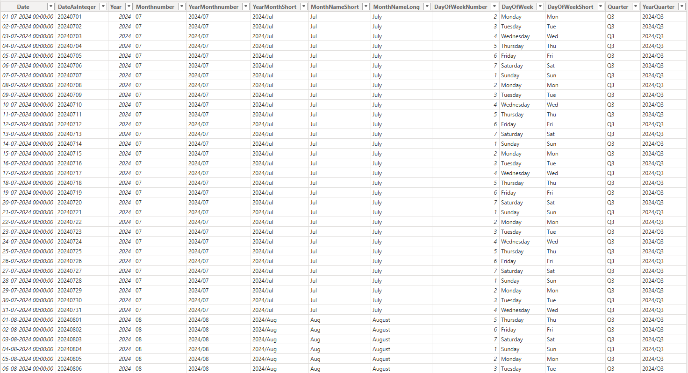
Acknowledged Limitations
Transparency is key to effective analysis. We acknowledge certain limitations inherent in our current dataset and analytical approach.
Simulated Data
The dataset used for this analysis is simulated, meaning it may not fully capture the complete diversity or nuances of actual customer behavior.
No Demographic Segmentation
Our current analysis does not include demographic segmentation, limiting insights into how different customer groups might behave or feel.
Keyword-Based Sentiment
Sentiment analysis relies primarily on keyword matching, which may not capture the full complexity of human emotion compared to advanced Natural Language Processing (NLP).
Limited Geographic Granularity
The analysis lacks detailed geographic granularity, preventing region-specific insights or localized strategic recommendations.

Slide 17




Conclusion: Driving Growth Through Data
This project demonstrates the powerful synergy between robust data analytics and strategic business outcomes. From defining objectives to delivering actionable recommendations, our process is designed to optimize performance.
1
Recommendations
2
Findings
3
Methodology
4
Objectives
Key Takeaway: Data analytics is not just about numbers; it's about empowering informed decisions that optimize product performance, enhance marketing effectiveness, and ultimately elevate customer satisfaction.

Slide 18
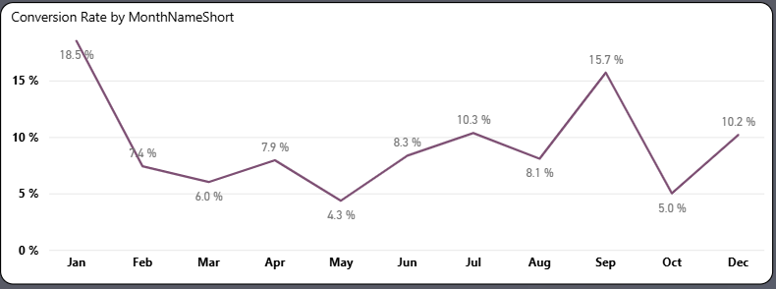
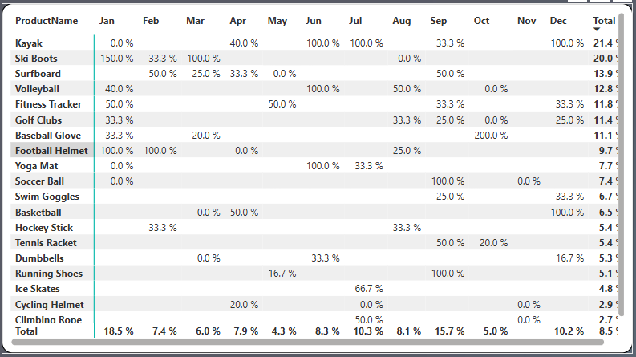
Unlocking E-commerce Growth: Conversion Insights
Understanding customer behavior is paramount for sustainable e-commerce growth. By meticulously analyzing conversion trends, we can identify opportunities, mitigate risks, and optimize pathways from homepage to checkout. This deep dive into conversion data reveals critical insights into user journeys and transactional success.
Conversion Rate Trends
Seasonal Spikes & Promotions
Drop-off Rate Analysis
Track monthly and quarterly conversion rates to understand performance over time and identify underlying patterns. This reveals the true health of our sales funnel.
Pinpoint periods of increased activity driven by festivals, holidays, or marketing campaigns. Leveraging these insights optimizes inventory and promotional strategies.
Analyze user drop-off points from homepage to checkout. Identifying bottlenecks helps streamline the purchase journey and reduce abandonment rates.

Slide 19
GitHub Link :
https://github.com/Soumyaditya24/Marketing_Analysis_of_Sports_Equipments
Thank You.

